Slide 1
Autonomous Car SLAM
By: Josh Field, Dan Romano, Annie Waye, David Yang
EECE 5554: Robotics Sensing and Navigation
April 6, 2020
Notes:
Note from Hanu in Piazza:
Innovation is secondary to the following aspects.
1. Making sure that in your presentation you can convince everyone that you understand, mathematically and intuitively what is going on in the code.
2. You understand the code enough that you can make it work on data that we provided that is different from the original dataset published by the authors of the paper/code on Github.
Presentation Schedule:
[4, 10, 6, 5, 1, 9, 8, 2, 3, 7, 11]
We will do 25 minute presentations per group (4 groups per class). (20 min presentation, 3-5 min questions)

Slide 2
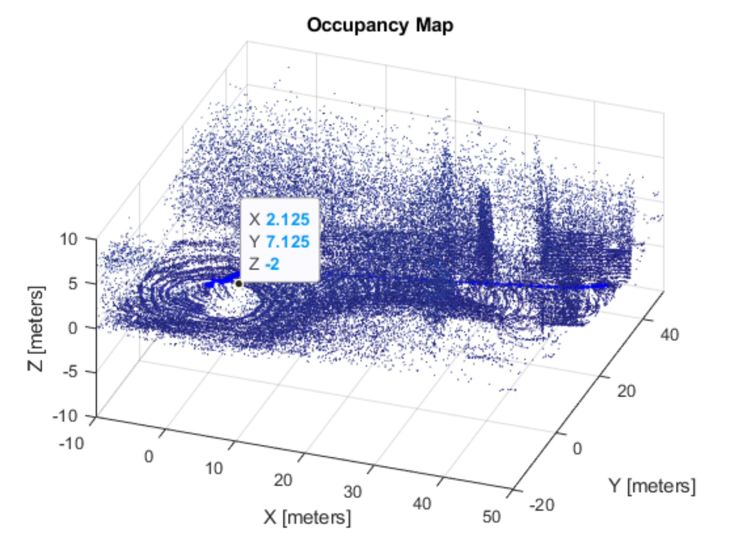
Project Goals
Determine Navigation and Mapping data using multiple methods and validate results
Visually map the surroundings
Track the position and orientation of the car
Check calibration and rectification
Compare with additional sensor methods
Notes:
constantly working to minimize error

Slide 3
Sensors/Data
Flir RGB Camera (2):
Raw images
Intrinsic + extrinsic calibration parameters
Velodyne LIDAR:
“PointCloud” messages
VectorNav IMU:
3-axis orientation
3-axis angular velocity
3-axis linear acceleration
GPS:
Latitude, longitude
Altitude
Fix

Slide 4
Processing Overview
Stereo Image Analysis
3D Map
Camera 0
Camera 1
Sensor Fusion (other sensors)
VSLAM
Final Position
IMU
Sensor Fusion (GPS, IMU)
GPS
Normal Distribution Transform
Lidar
Data
CV Analysis
Fusion
Navigation
Notes:
Predominantly in MATLAB as of April 6, 2020

Slide 5
IMU/GPS Fusion
If GPS Available
IMU Only
Motion Model
Predicted State
Corrected State
IMU
High Rate ~ 100 Hz
Kalman Update
GPS
Low Rate ~ 1 Hz

Slide 6
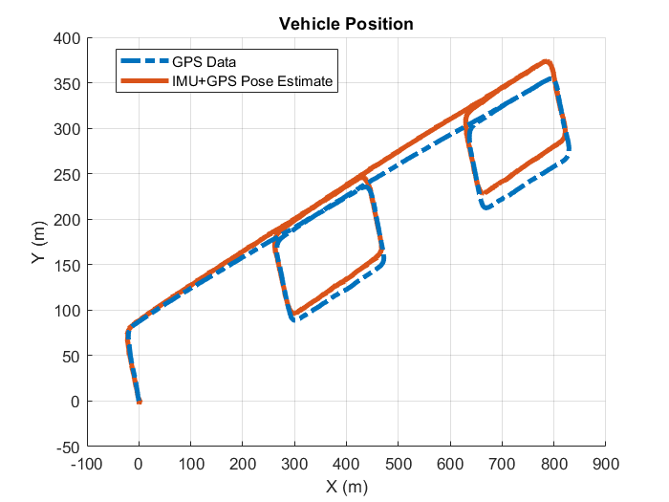
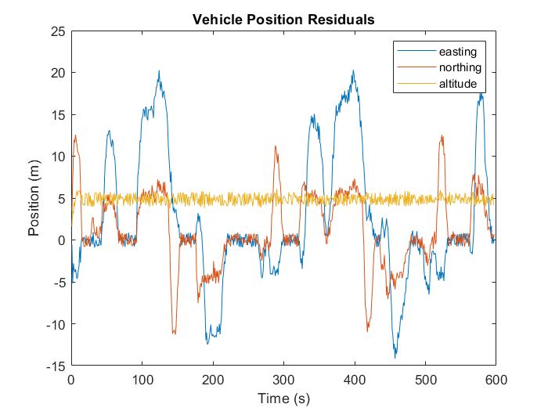
IMU/GPS Fusion Results

Slide 7
Visual-Inertial Sensor Fusion
If GPS/ VO Available
IMU Only
Motion Model
Predicted State
Corrected State
IMU
High Rate ~ 100 Hz
Kalman Update
GPS
Low Rate ~ 1 Hz
VO
Low Rate ~ 1 Hz

Slide 8
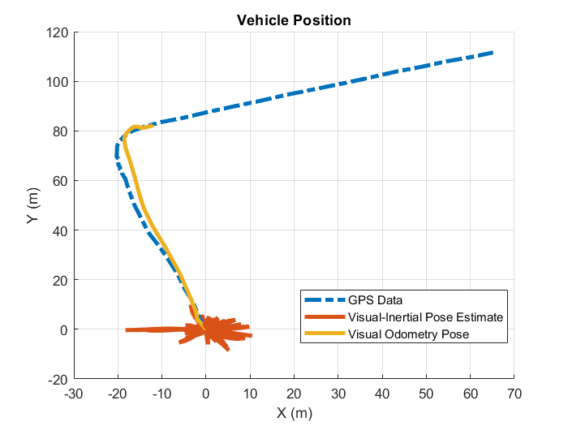
Visual-Inertial Sensor Fusion Results

Slide 9
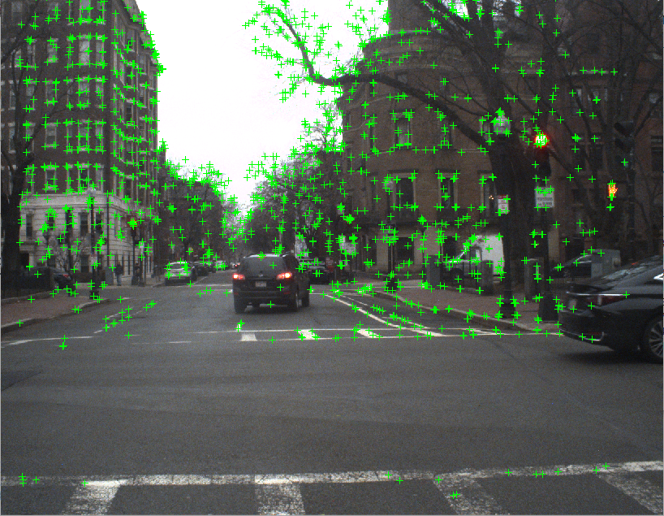
VSLAM Process: Feature Detection
ORB Feature Detection
Uniform Selection
Feature Matching
Transformation Calculation
Image
Current results:
Good detection of features but issues matching features against world points on turns
currently solved by allowing more error

Slide 10
VSLAM Process: Mapping
Mapping is all based off of matlab example “Monocular Visual Simultaneous Localization and Mapping”
NO
>140
YES
Number of matched features (to 3d map)
2 frames initialize map
Frame and features stored as keyframe
Camera Position values calculated from keyframe
Camera 0
Translation and Rotation
World Point Positions Calculated and Stored for 3d map creation
3D Point Cloud

Slide 11
VSLAM Process: Loop Closure
Not working yet, but the process is outlined below:
NO
Position and Map Determination
New Keyframe Detected
Compare to Previous Frames
Match?
Known Position, Less Error
YES

Slide 12
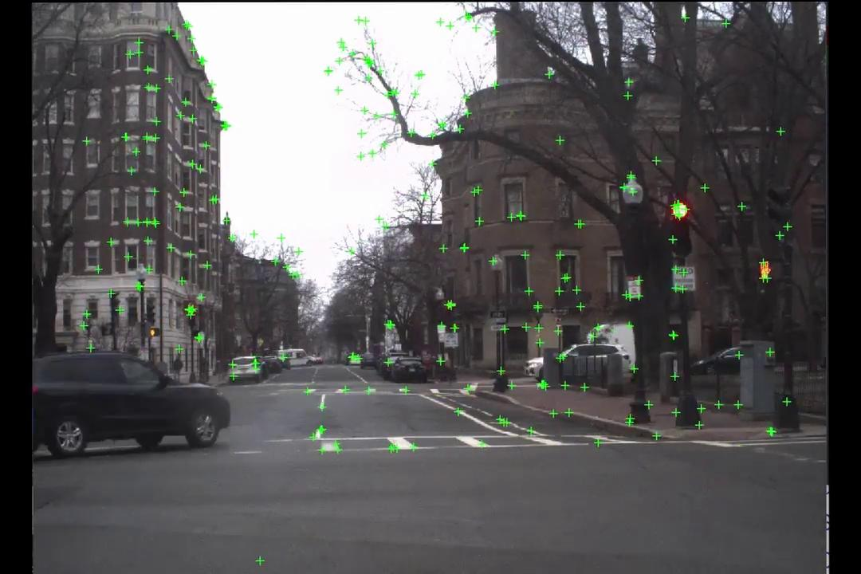
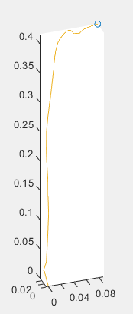
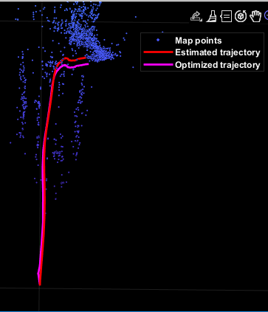
VSLAM Results

Slide 13
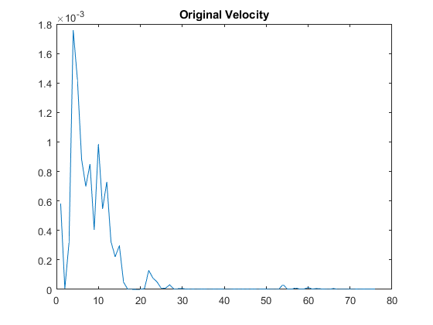
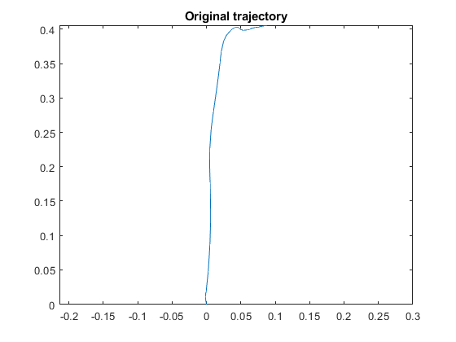
VSLAM Results

Slide 14
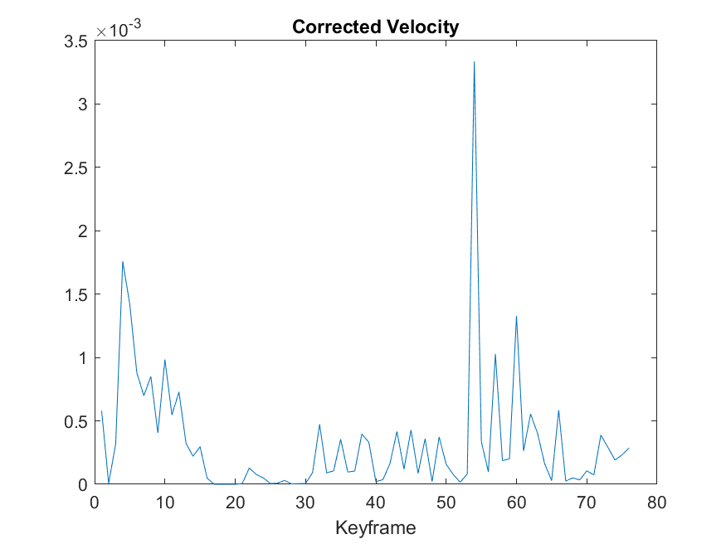
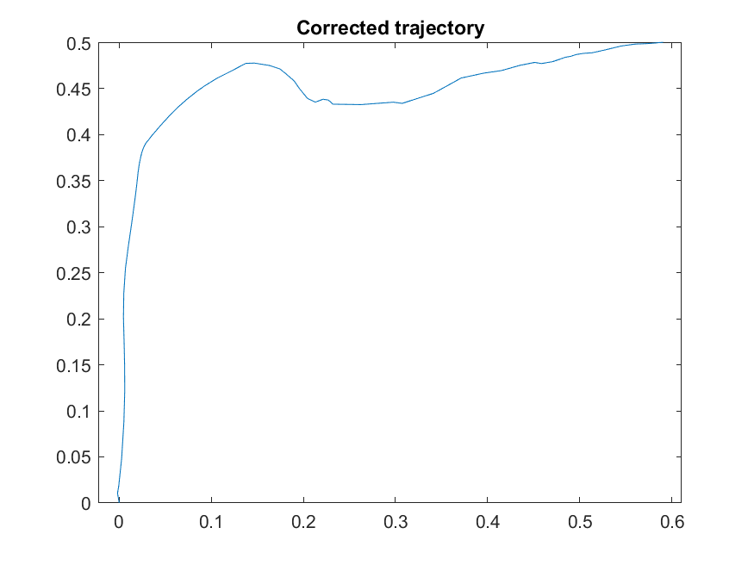
VSLAM Results
Note: No scale on units for trajectory as we are using monocular vision

Slide 15
LIDAR Process
Occupancy map
Update current pose and occupancy map if pose change is significant
Current
pose
Relative Pose estimate
...
pc_n
pc_(n+1)
pc_(n+1)
...

Slide 16
LIDAR Results

Slide 17
Stereo Image Analysis
Stereo Image Sample 1: Removed Outliers
Stereo Image Sample 2
Notes:
Goals: determine if the two frames moved enough to warrant a new position estimate from slam?
Match features, set stereo parameters, rectify calibrated image pairs
Visualize the disparities between cam0 and cam1
improve the quality of detected features

Slide 18
Next Steps
Utilize Stereo Vision for scale in VSLAM
Improve sensor Fusion
Add Lidar
Reduce Drift
Incorporate SLAM - Rotation issues at the moment
Allow map generation for entire dataset from VSLAM
Currently at 20000 point limit at ~ 2 Minutes of data

Slide 19
Questions?

Slide 20
References
Dataset “car_IR_RGB_lidar”
Monocular Visual Simultaneous Localization and Mapping

